Slide 1
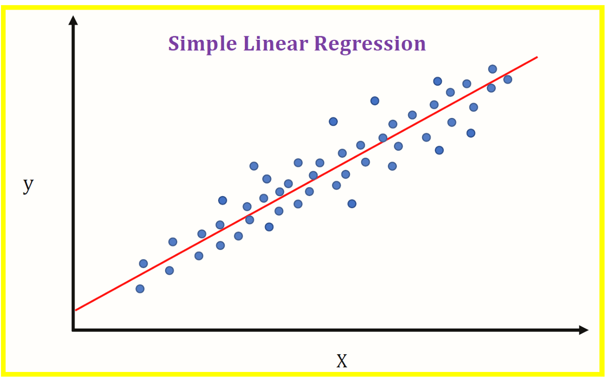
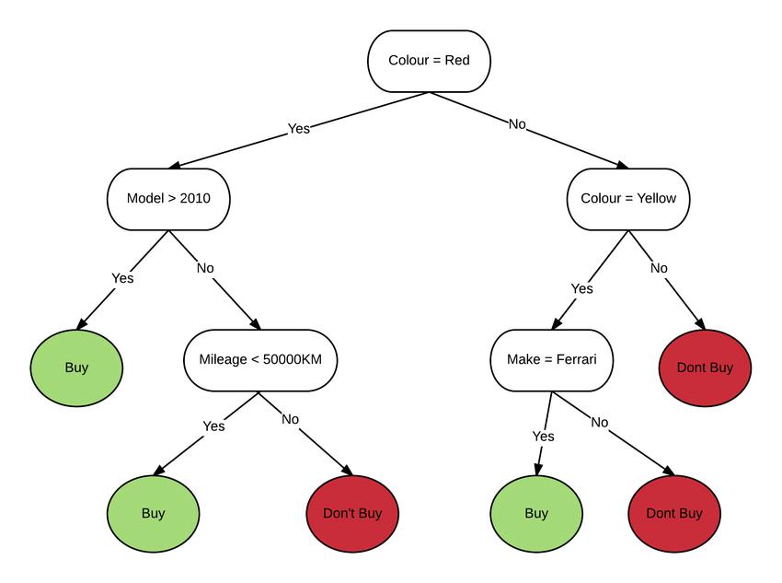
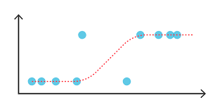
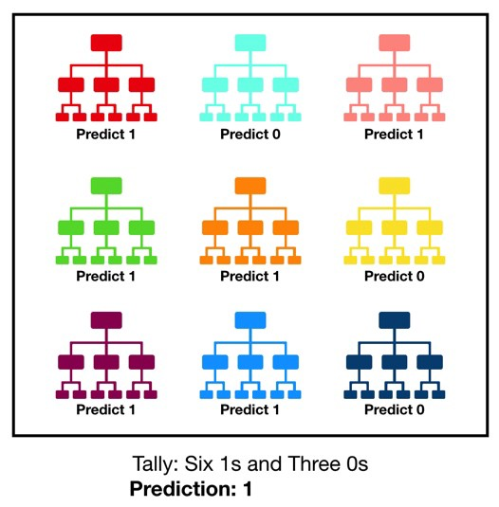
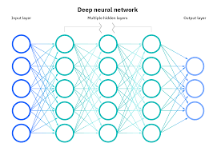
Rnd. 1
Rnd. 2
Missing Values
‘MinGift’
‘MaxGift’
‘TotalGift’
‘Recency’
‘Frequency’
‘Seniority’
New Features
‘is_vip’
‘is_active’
‘is_potential’
Missing Values
‘MinGift’
‘MaxGift’
‘TotalGift’
‘Recency’
‘Frequency’
‘Seniority’
New Features
‘is_vip’
‘is_active’
‘is_potential’
‘AvgGift’
Variables Dummies
‘Education’
‘City’
Modelos Probados
Modelos Conditional Amt.
Modelos Prob. of Giving
Resultados
Resultados
Russel Rosique A01283727

